Slide 1
Tensor Convolution Operation in PEs
Prepared By: Peter A. Beerel and Souvik Kundu

Slide 2
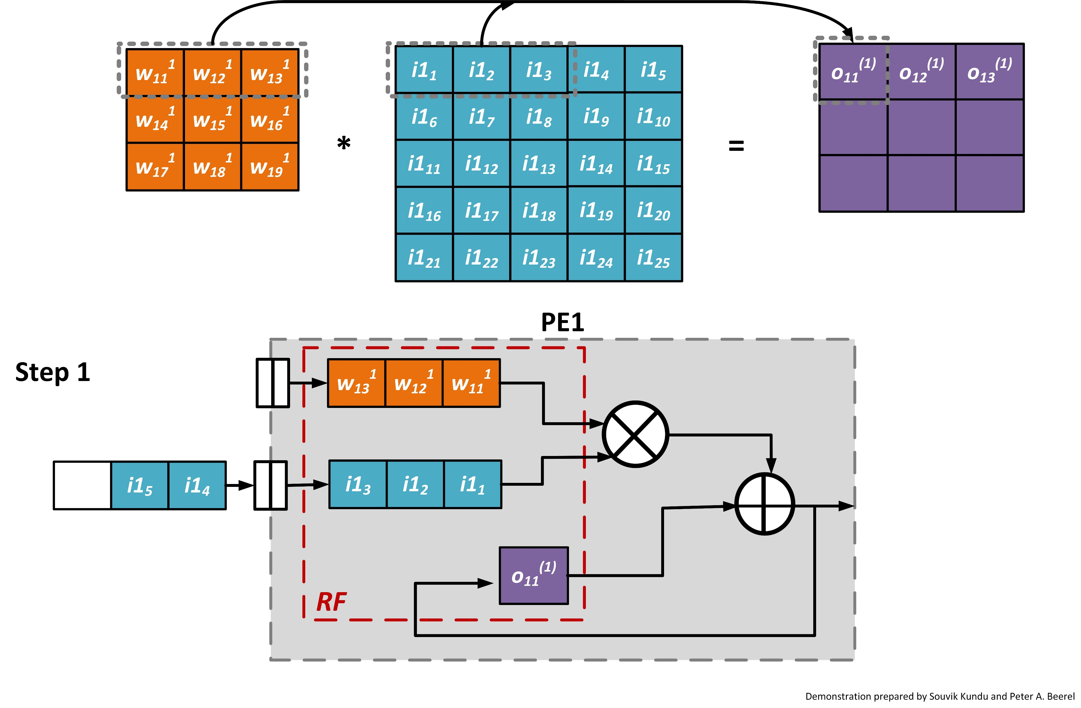
Simplified Tensor Convolution
Here we assumed ROW stationary data flow, i.e. each row is handled by a separate processing element (PE)
Here we assumed the stride value of 1, and input patch changes after each stride
Demonstration of PE1’s handling of operation with initial input patch

Slide 3
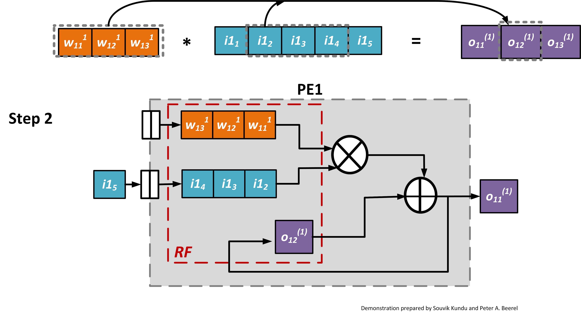
Simplified Tensor Convolution (contd.)
Demonstration of PE1’s handling of operation with input patch at first stride shift

Slide 4
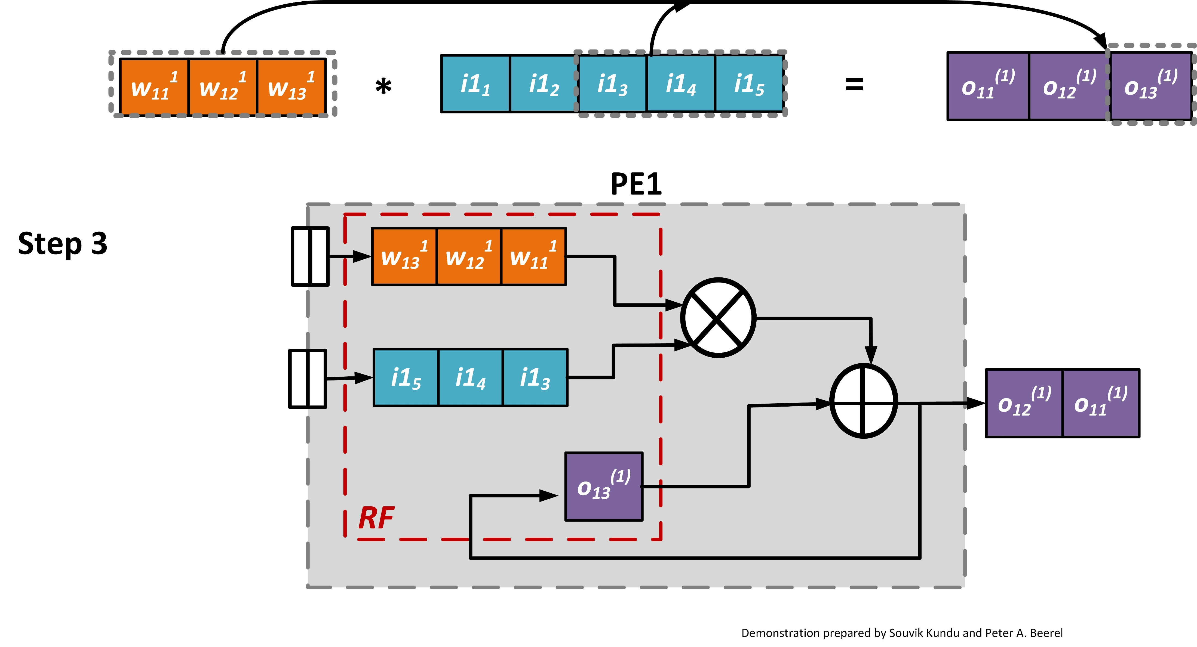
Simplified Tensor Convolution (contd.)
Demonstration of PE1’s handling of operation with input patch at second stride shift

Slide 5
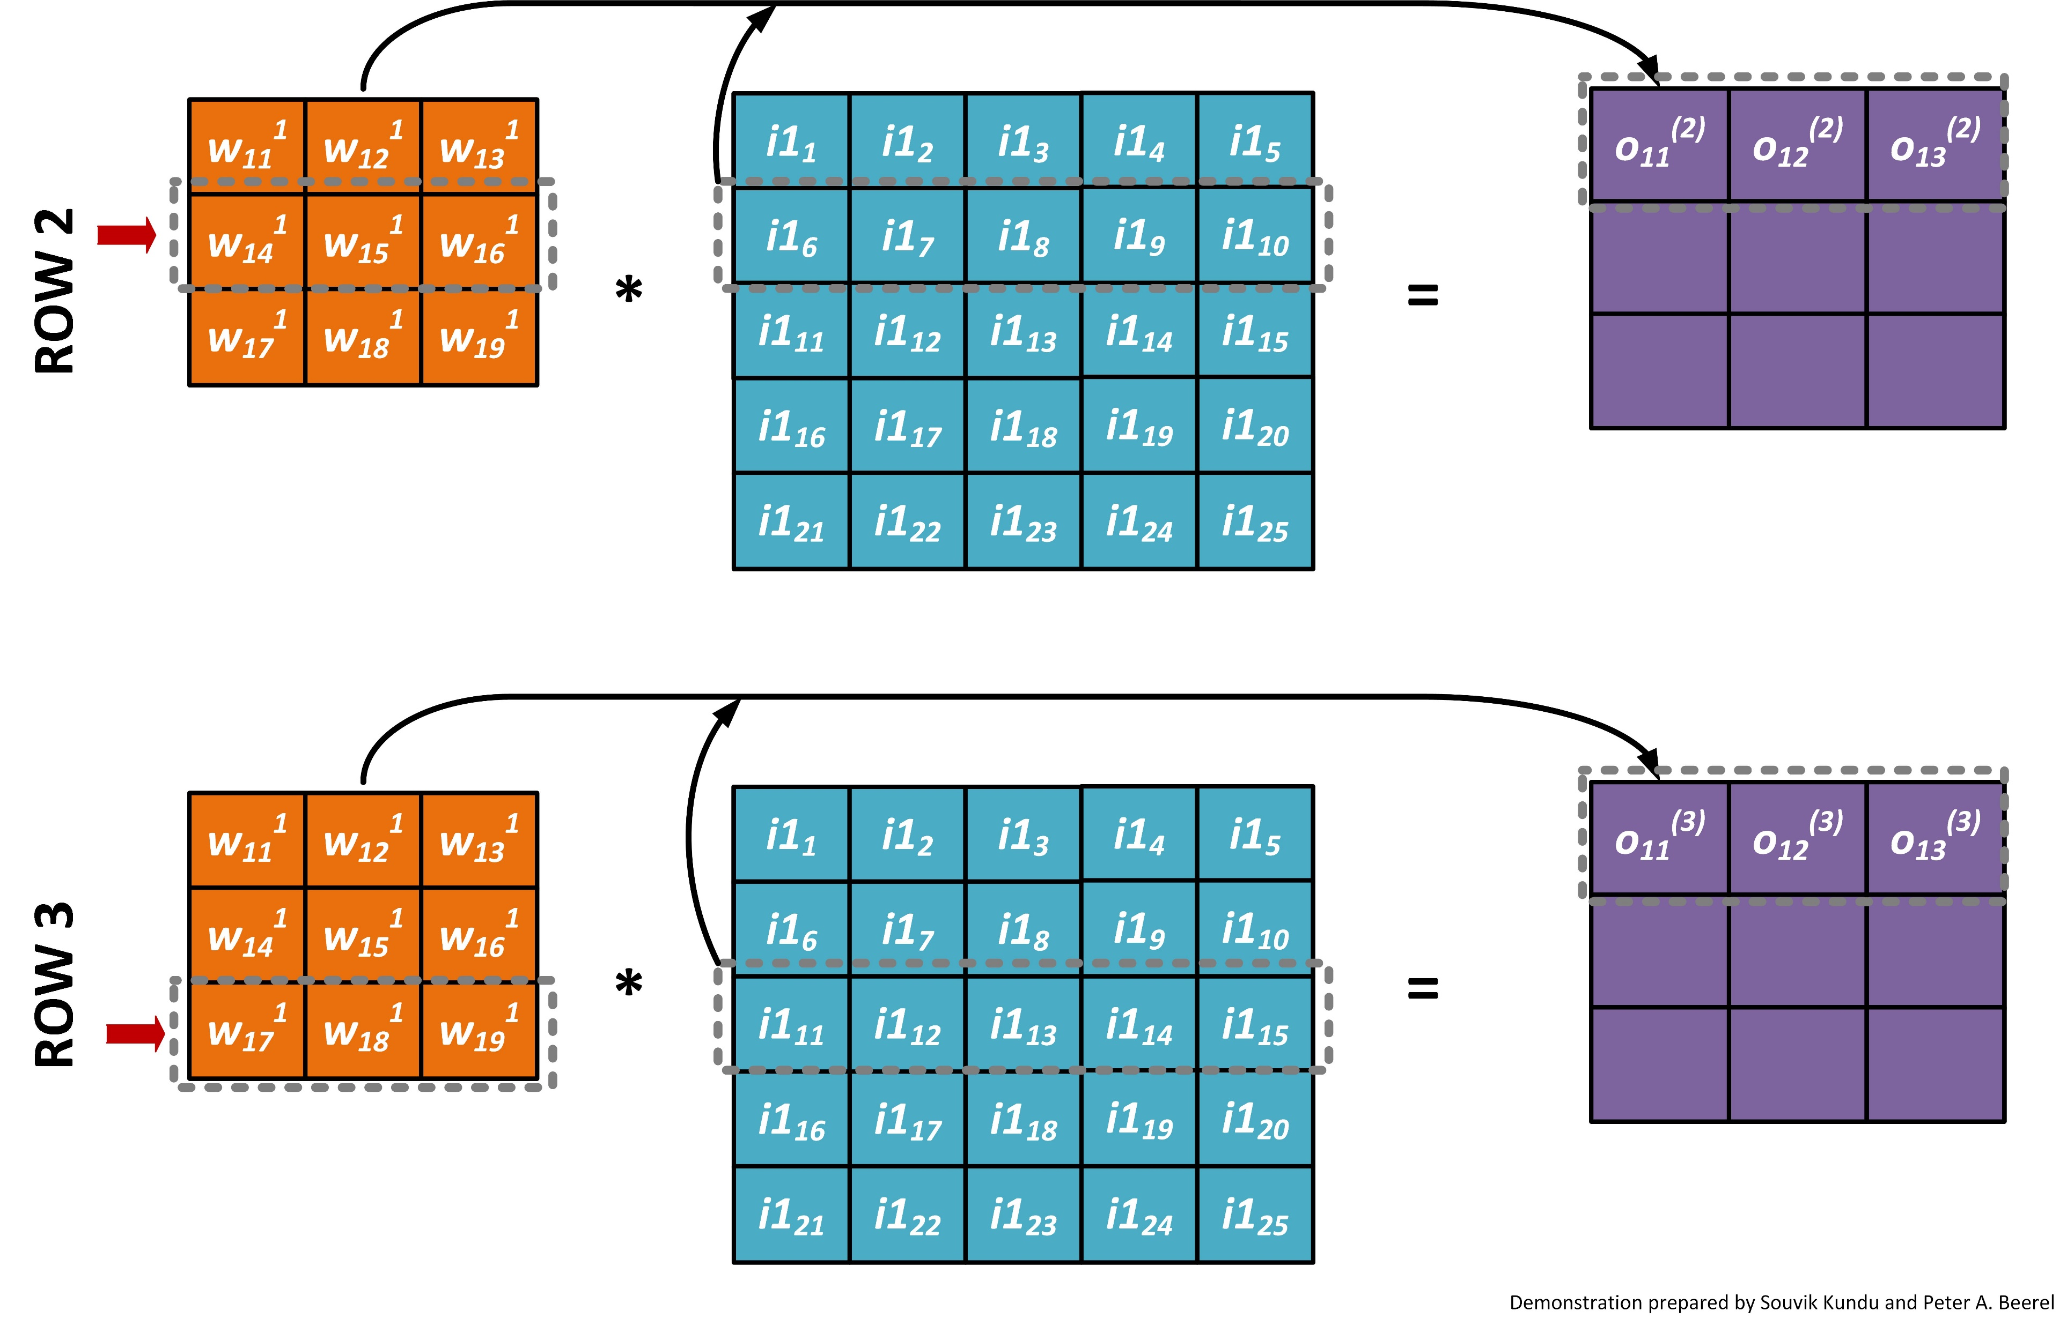
Similar computations in PE2 and PE3
If there are 3 Pes, then ROW 2 and
ROW 3 can be handled in parallel in PE2 and PE3, respectively, while PE1 handles ROW 1.

Slide 6
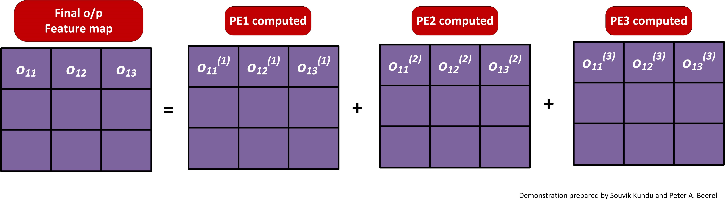
Final output feature map computation
Computed first row of output feature map by adding the partial sums (psum) from each PE.
E.g: O₁₁ = O₁₁⁽¹⁾ + O₁₁⁽²⁾ + O₁₁⁽³⁾

